Slide 1


CMPE 135: Object-Oriented Analysis and Design November 21 Class Meeting
Department of Computer Engineering San Jose State University Fall 2017 Instructor: Ron Mak
www.cs.sjsu.edu/~mak

Slide 2
Unofficial Field Trip
Computer History Museum in Mt. View
http://www.computerhistory.org/
Provide your own transportation to the museum.
Saturday, December 9, 11:30 – closing time
Special free admission.
Do a self-guided tour of the Revolution exhibit.
See a life-size working model of Charles Babbage’s Difference Engine in operation, a hand-cranked mechanical computer designed in the early 1800s.
Experience a fully restored IBM 1401 mainframe computer from the early 1960s in operation.

Slide 3
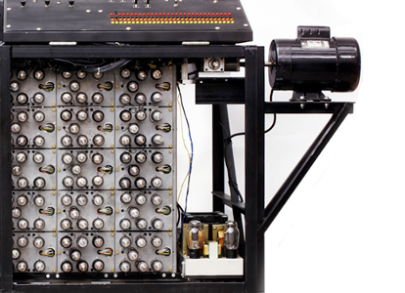
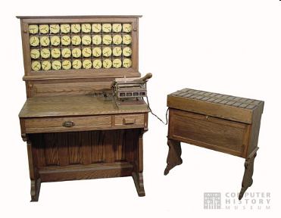
Unofficial Field Trip, cont’d
See the extensive Revolution exhibit!
Walk through a timeline of the First 2000 Years of Computing History.
Historic computer systems, data processing equipment, and other artifacts.
Small theater presentations.
Hollerith
Census
Machine
Atanasoff-Berry
Computer

Slide 4
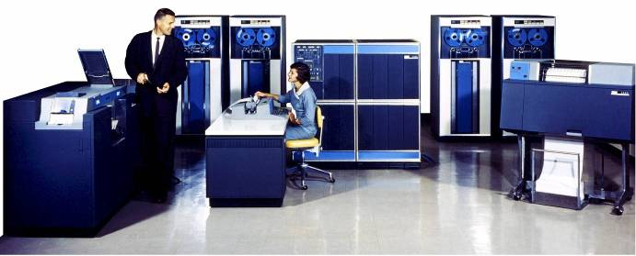
Unofficial Field Trip, cont’d
IBM 1401 computer, fully restored and operational.
A small transistor-based mainframe computer.
Extremely popular with small businesses in the late 1950s through the mid 1960s
Maximum of 16K bytes of memory.
800 card/minute card reader (wire brushes).
600 line/minute line printer (impact).
6 magnetic tape drives, no disk drives.

Slide 5
Unofficial Field Trip, cont’d
Information on the IBM 1401:
General info: http://en.wikipedia.org/wiki/IBM_1401
My summer seminar: http://www.cs.sjsu.edu/~mak/1401/
Restoration: http://ed-thelen.org/1401Project/1401RestorationPage.html

Slide 6
Design Patterns We’ve Covered
Strategy
Observer
Decorator
Factory Method
Abstract Factory
Singleton
Adapter
Facade
State
Iterator
Composite
Template Method

Slide 7
Design Patterns and Qt
Qt is a multiplatform desktop applications and GUI development toolkit.
Mac, Linux, Windows, mobile, ...
Uses standard C++ with extensions.
Notable users
KDE Plasma desktop environment
Tesla Model S
Adobe Photoshop
Google Earth
Skype

Slide 8
Design Patterns and Qt, cont’d
Uses design patterns?
Composite
Abstract Factory
Singleton
Facade
Iterator
Observer
Strategy

Slide 9
Extensions to Standard C++
Qt extends standard C++
new data types (classes)
new macros
new cross-platform GUI library

Slide 10
Example: QStringList and Iteration
#include <QStringList>
#include <QDebug>
int main()
{
QString winter = "December, January, February";
QString spring = "March, April, May";
QString summer = "June, July, August";
QString fall = "September, October, November";
QStringList list;
list << winter;
list += spring;
list.append(summer);
list << fall;
qDebug() << "The spring months in a QStringList: " << list[1] ;
lists-examples.cpp
Different ways
to append
to the list.
The spring months in a QStringList: "March, April, May"

Slide 11
Example: QStringList and Iteration, cont’d
qDebug() << "\nAll the months in a joined QString:";
QString allmonths = list.join(", ");
qDebug() << allmonths;
Convert from the list to a string.
All the months in a joined QString:
"December, January, February, March, April, May, June, July, August, September, October, November"
qDebug() << "\nThe four seasons using the Qt foreach:";
foreach (const QString &str, list)
{
qDebug() << QString(" [%1] ").arg(str);
}
foreach is a Qt macro.
The four seasons using the Qt foreach:
" [December, January, February] "
" [March, April, May] "
" [June, July, August] "
" [September, October, November] "
A Qt implementation of the
iterator design pattern.

Slide 12
Example: QStringList and Iteration, cont’d
qDebug() << "\nThe four seasons using an STL iterator:";
for (QStringList::iterator it = list.begin(); it != list.end(); ++it)
{
QString current = *it;
qDebug() << "[[" << current << "]]";
}
The four seasons using an STL iterator:
[[ "December, January, February" ]]
[[ "March, April, May" ]]
[[ "June, July, August" ]]
[[ "September, October, November" ]]

Slide 13
Example: QStringList and Iteration, cont’d
qDebug() << "\nThe months using a Qt iterator:";
QListIterator<QString> itr (list2);
while (itr.hasNext())
{
QString current = itr.next();
qDebug() << "{" << current << "}";
}
return 0;
}
Java-style Qt iterator.
The months using a Qt iterator:
{ "December" }
{ "January" }
{ "February" }
{ "March" }
{ "April" }
{ "May" }
{ "June" }
{ "July" }
{ "August" }
{ "September" }
{ "October" }
{ "November" }
Another Qt implementation of the
iterator design pattern.

Slide 14
Abstraction of the GUI
Qt uses the native style APIs of the different platforms that it runs on.
Qt GUI apps look like native GUI apps.
Example: Qt on Linux-based systems.
By Shmuel Csaba Otto Traian, CC BY-SA 3.0,
https://commons.wikimedia.org/w/index.php?curid=27799196

Slide 15
Qt Tools
moc metaobject compiler
Reads the sources of a Qt program.
Generates added C++ code to provide programming features not available natively in C++.
qmake cross-platform build script generator
Generates makefiles to develop applications across different platforms.
Qt Creator cross-platform IDE for C++
Includes a drag-and-drop editor to create GUIs.

Slide 16
Qt Creator
https://commons.wikimedia.org/w/index.php?curid=36219689

Slide 17
Qt Signals and Slots
A Qt language construct for communication between objects.
GUI widgets send signals containing event information.
Other controls receive the signals using special functions known as slots.
Implement the observer design pattern.

Slide 18
Download and Install Qt
Download from https://www1.qt.io/download-open-source/?hsCtaTracking=f977210e-de67-475f-a32b-65cec207fd03%7Cd62710cd-e1db-46aa-8d4d-2f1c1ffdacea#section-2
Mac: After installing, you must build the library.
Follow the instructions in 5.9.2/Src/qtbase/lib/README
Install the include files in /usr/local/qt5/include
Install the library files in /usr/local/qt5/lib

Slide 19
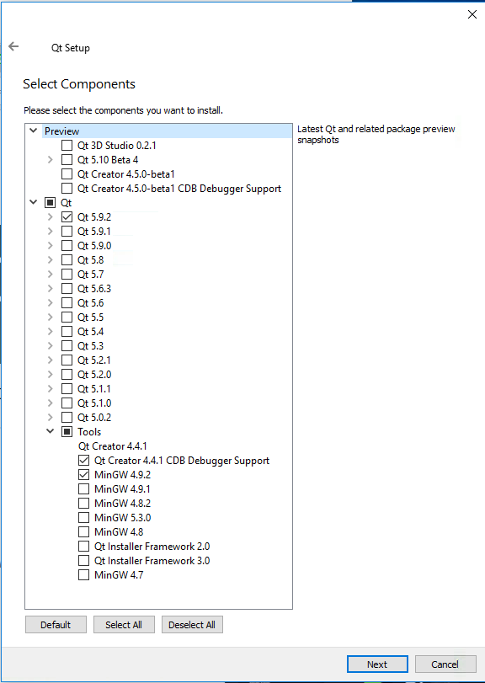
Download and Install Qt, cont’d
Windows
Download and install MinGW along with Qt.
Trying to use a previous installation of MinGW doesn’t seem to work.

Slide 20
Example Qt Program: Simple
simple.cpp
#include <QApplication>
#include <QWidget>
int main(int argc, char *argv[])
{
QApplication app(argc, argv);
QWidget window;
window.resize(250, 150);
window.setWindowTitle("Simple example");
window.show();
return app.exec();
}

Slide 21
Example Qt Program: Simple, cont’d
To build the example:
Generates file qt.pro:
qmake -project
######################################################################
# Automatically generated by qmake (3.1) Sun Nov 19 15:22:01 2017
######################################################################
TEMPLATE = app
TARGET = qt
INCLUDEPATH += .
# The following define makes your compiler warn you if you use any
# feature of Qt which has been marked as deprecated (the exact warnings
# depend on your compiler). Please consult the documentation of the
# deprecated API in order to know how to port your code away from it.
DEFINES += QT_DEPRECATED_WARNINGS
# You can also make your code fail to compile if you use deprecated APIs.
# In order to do so, uncomment the following line.
# You can also select to disable deprecated APIs only up to a certain version of Qt.
#DEFINES += QT_DISABLE_DEPRECATED_BEFORE=0x060000 # disables all the APIs
# deprecated before Qt 6.0.0
# Input
SOURCES += simple.cpp
QT += widgets

Slide 22
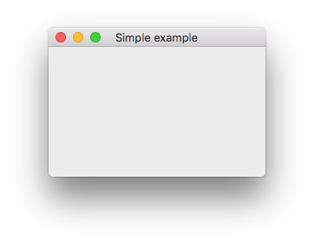
Example Qt Program: Simple, cont’d
Run qmake again to generate a makefile, and then make the app:
Run the app:
qmake
make

Slide 23
Example Qt Program: Factorials
#include <QApplication>
#include <QInputDialog>
#include <QMessageBox>
#include <QTextStream>
int main (int argc, char* argv[])
{
QApplication app(argc, argv);
QTextStream cout(stdout);
int answer = 0;
do {
int n = QInputDialog::getInt(0, "Factorial Calculator",
"Factorial of:", 1);
int i = 2;
int nfact = 1;
while (i <= n) nfact *= i++;
QString response = QString("The nfactorial of %1 is %2.\n%3")
.arg(n).arg(nfact)
.arg("Compute another nfactorial?");
answer = QMessageBox::question(0, "Play again?", response,
QMessageBox::Yes | QMessageBox::No);
} while (answer == QMessageBox::Yes);
return EXIT_SUCCESS;
}

Slide 24
Example Qt Program: Factorials, cont’d
qmake -project
######################################################################
# Automatically generated by qmake (3.1) Sun Nov 19 22:48:25 2017
######################################################################
TEMPLATE = app
TARGET = factorial
INCLUDEPATH += .
DEFINES += QT_DEPRECATED_WARNINGS
# Input
SOURCES += factorial.cpp
QT += widgets
qmake
make

Slide 25
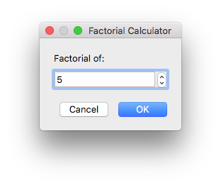
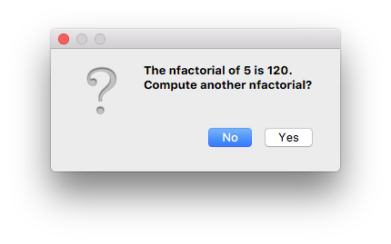
Example Qt Program: Factorials, cont’d

Slide 26
Qt Creator
A cross-platform, complete integrated development environment (IDE) for application developers.
Create applications for multiple desktop, embedded, and mobile device platforms.
Linux, Mac OS, and Windows
Android and iOS
Drag-and-drop editor to create GUIs.

Slide 27
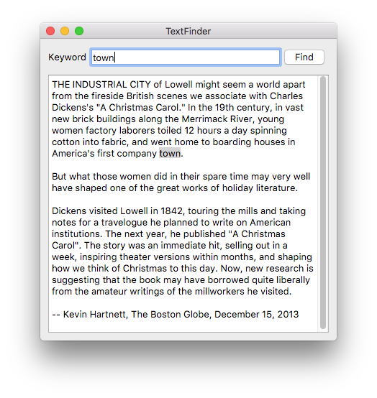
Example: Text Finder Project
A app that searches for matches in some text.

Slide 28
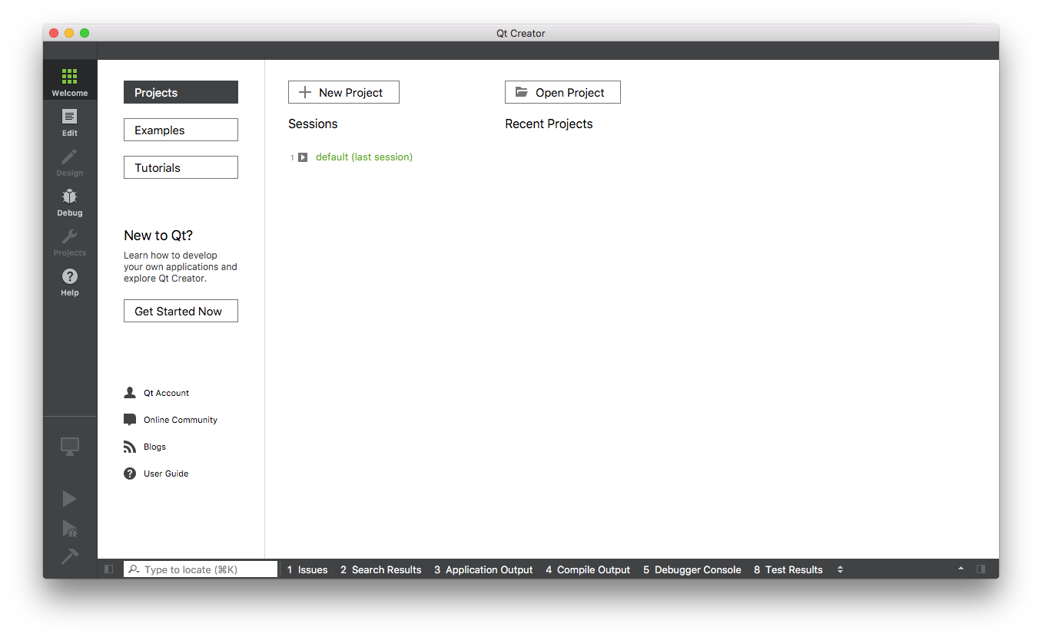
Example: Text Finder Project, cont’d

Slide 29
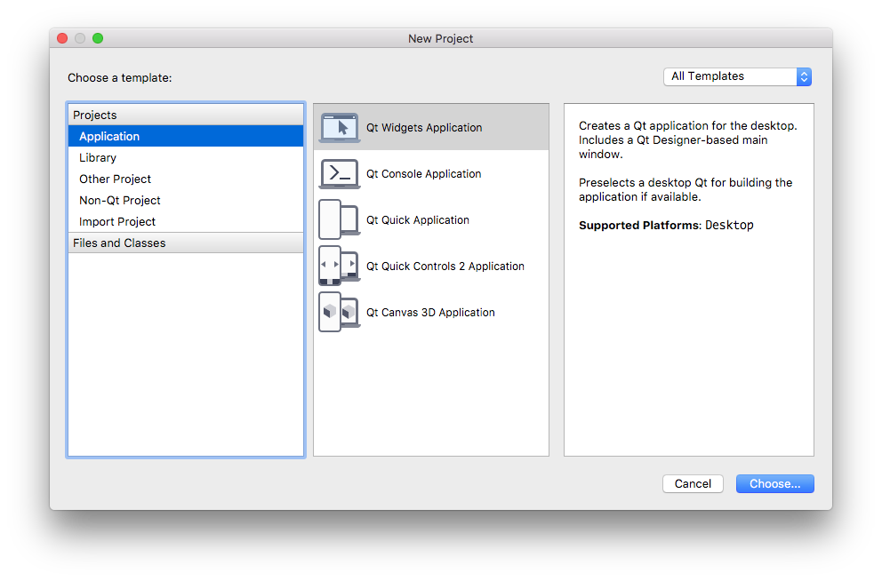
Example: Text Finder Project, cont’d

Slide 30
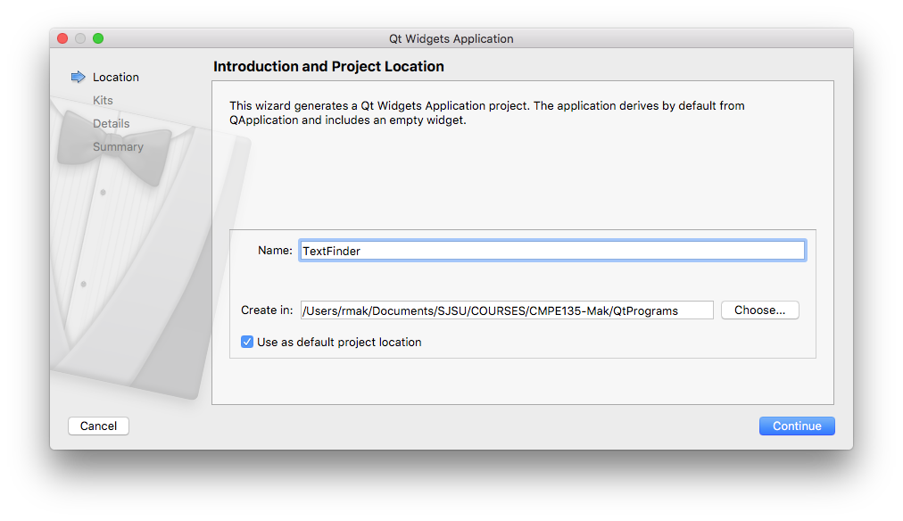
Example: Text Finder Project, cont’d

Slide 31
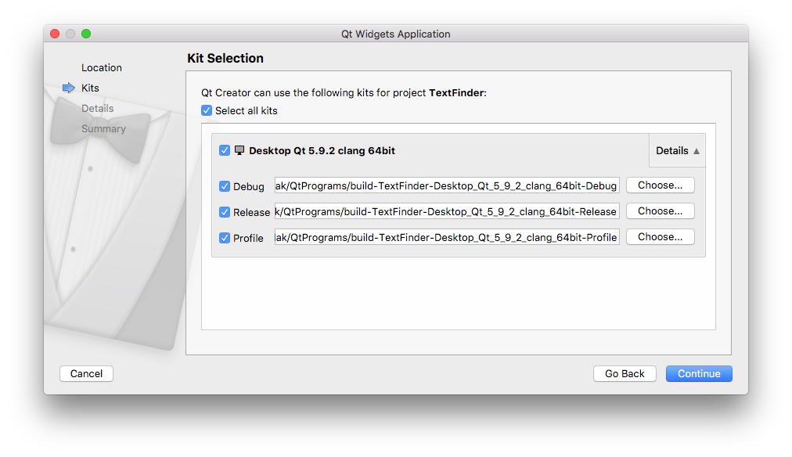
Example: Text Finder Project, cont’d

Slide 32
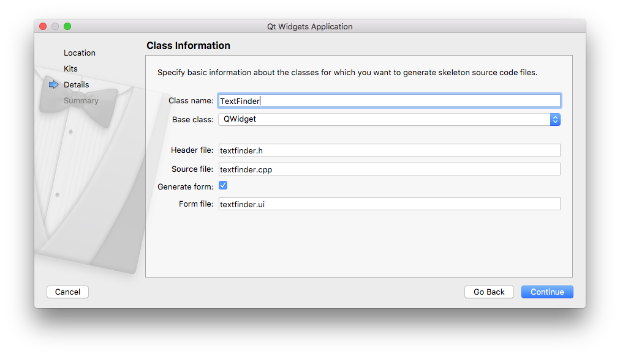
Example: Text Finder Project, cont’d

Slide 33
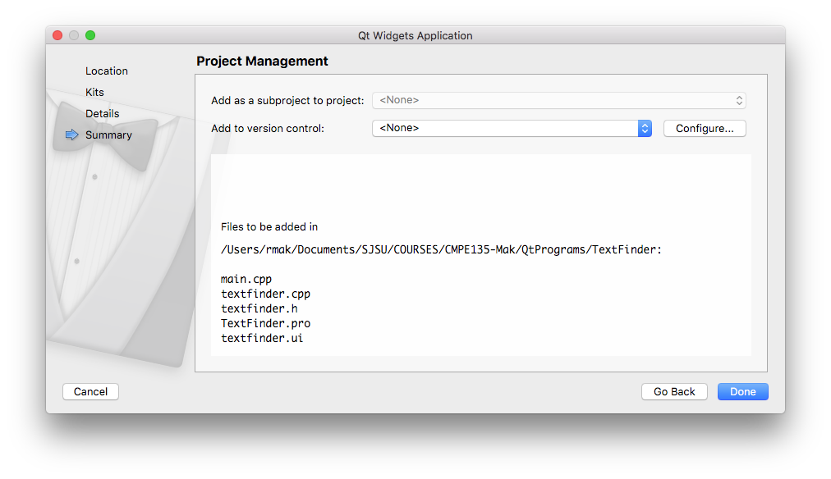
Example: Text Finder Project, cont’d

Slide 34
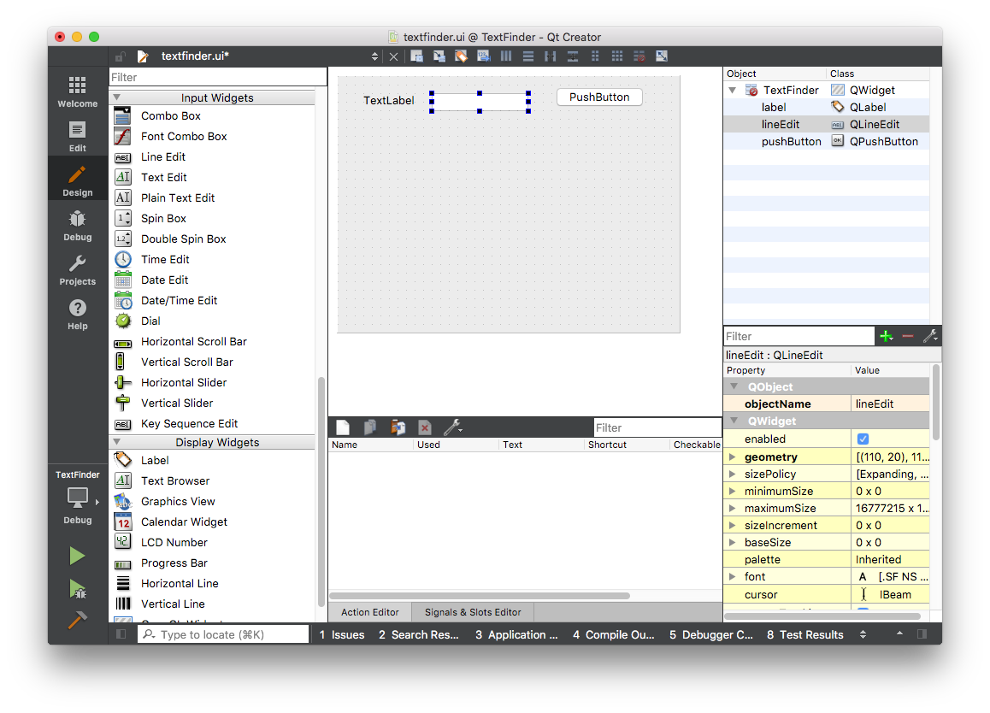
Example: Text Finder Project, cont’d

Slide 35
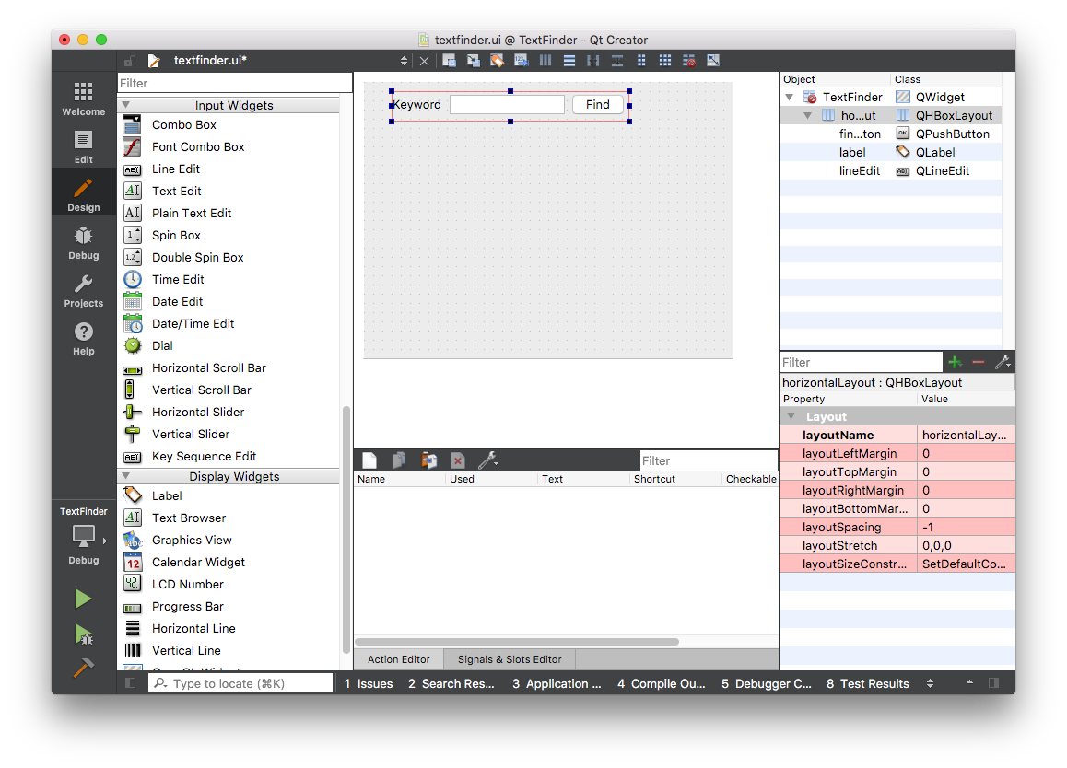
Example: Text Finder Project, cont’d

Slide 36
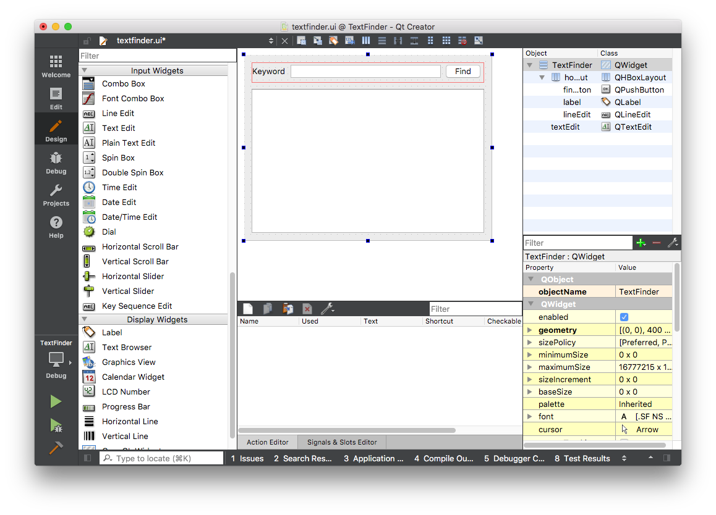
Example: Text Finder Project, cont’d

Slide 37
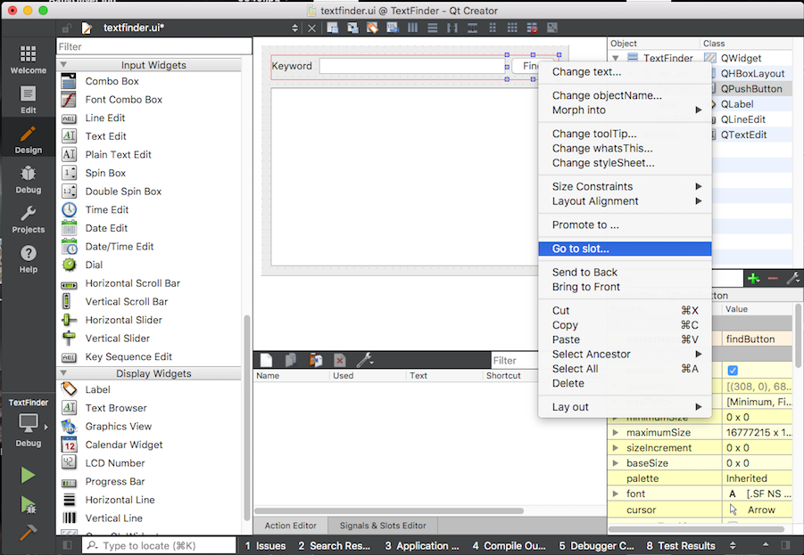
Example: Text Finder Project, cont’d

Slide 38
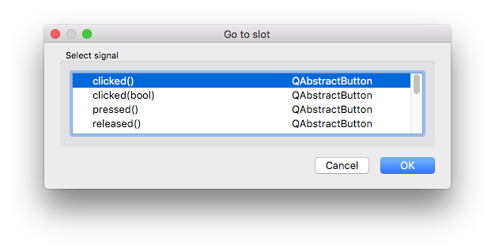
Example: Text Finder Project, cont’d

Slide 39
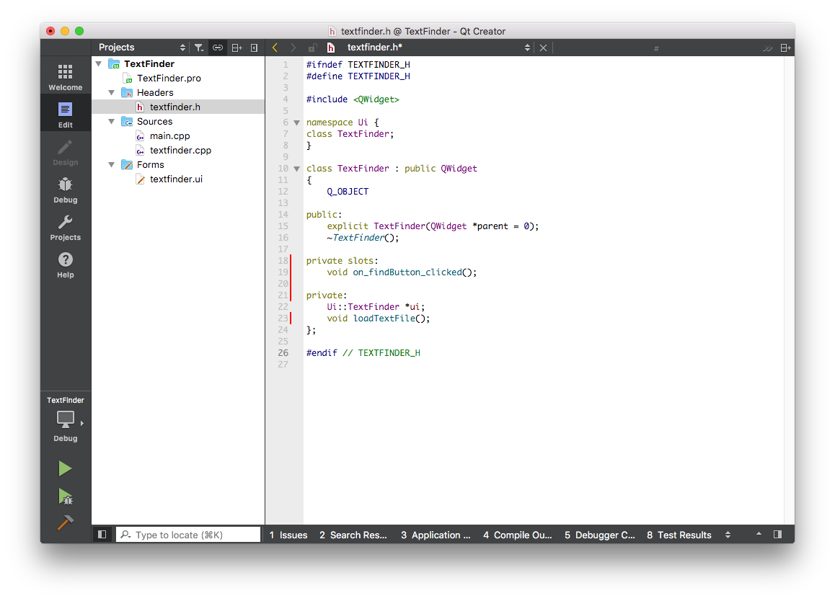
Example: Text Finder Project, cont’d

Slide 40
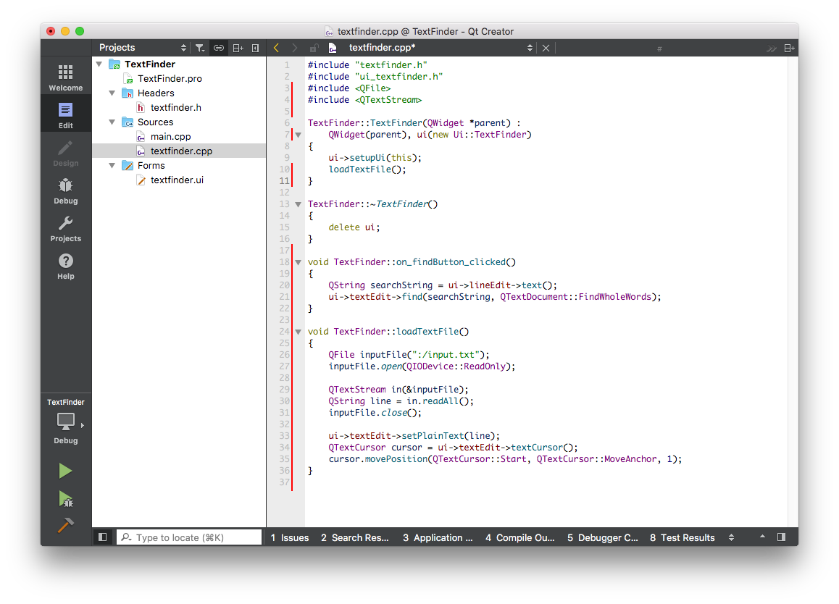
Example: Text Finder Project, cont’d

Slide 41
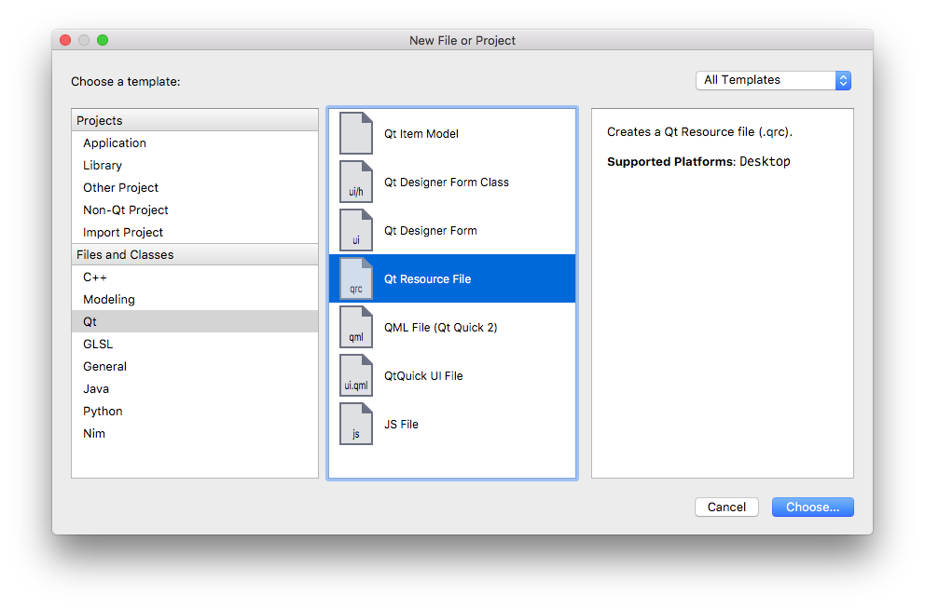
Example: Text Finder Project, cont’d

Slide 42
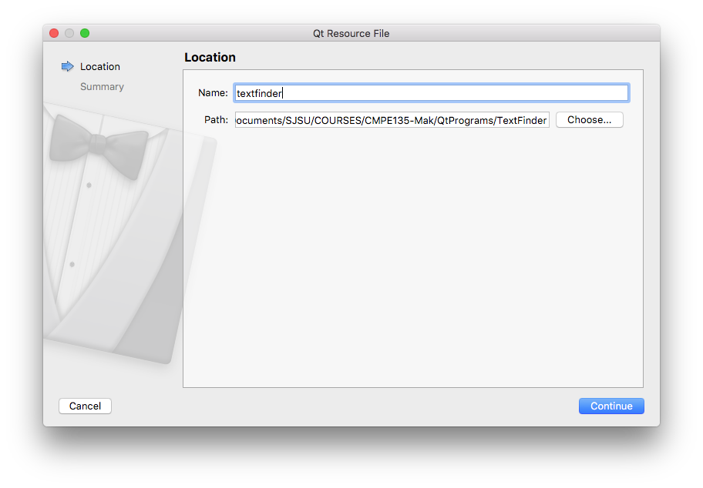
Example: Text Finder Project, cont’d

Slide 43
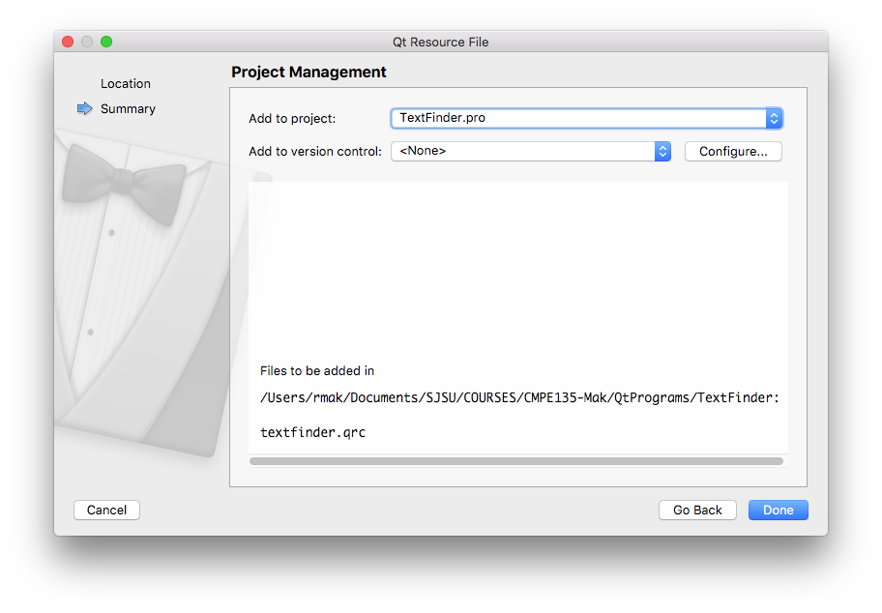
Example: Text Finder Project, cont’d

Slide 44
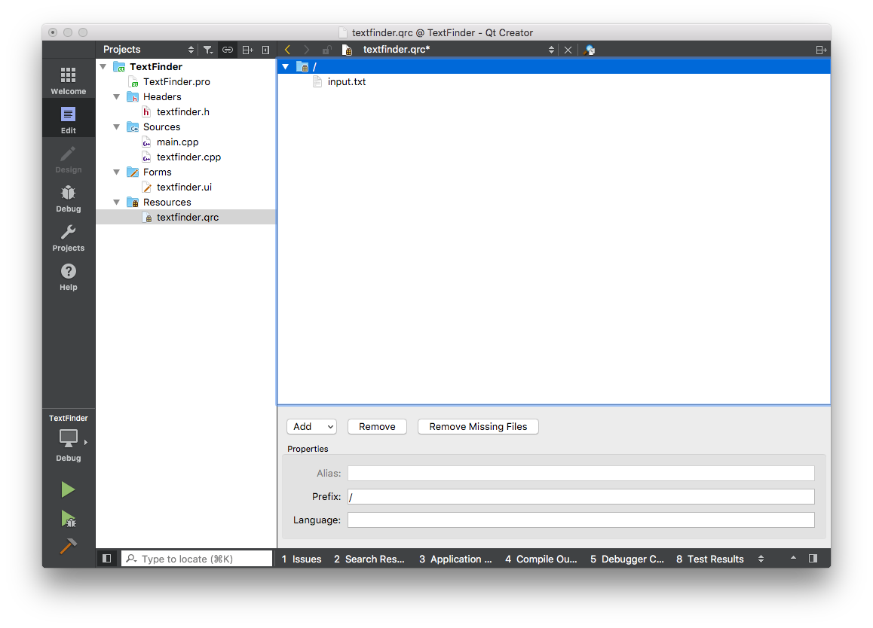
Example: Text Finder Project, cont’d

Slide 45
Who’s in Control?
Standard text-based program
Your program is in control.
Your program determines the application flow.
Interactive GUI-based program
Inversion of control.
Your program waits for events to occur.
Your program reacts to events when they occur.
The GUI framework that interacts with the user is in control.

